Slide 1

By Chetan Mathur
Business Analyst Career Program – Capstone Project

Slide 2

Agenda
Data Exploration
Statistical Analysis using Excel
Graphical Analysis using Excel
Insert the given data into the SQL server
Interactive Dashboard by using visualization tools
Conclusion and Inferences

Slide 3
Data Exploration
Western Countries Financial Data
The data that we need to analyze is related to the same products that are manufactures in different conditions or regions with different market scenarios or demographic of a country or region & market segment which create variations in manufacturing price, sale price, discount bands or profits of similar kind of products.
The data that we have is in structured form contain dimensions & measures.
The data contain 16 columns & 700 rows.

Slide 4
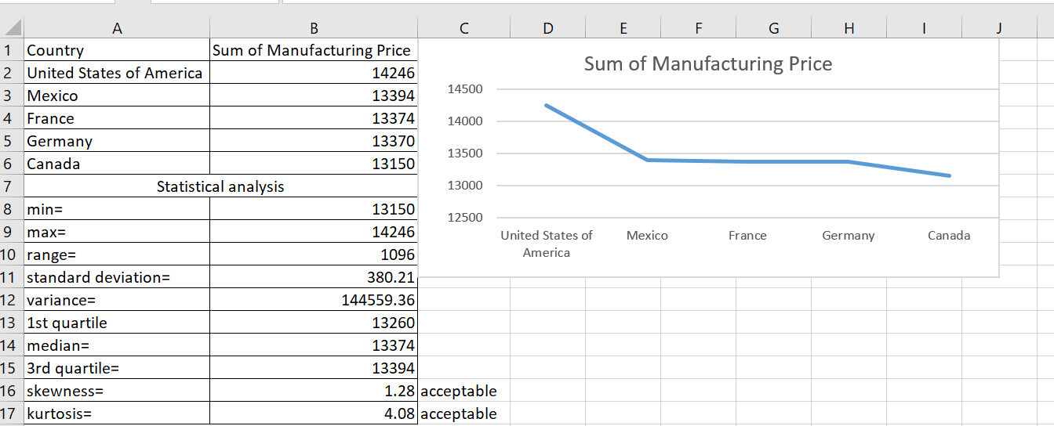
Statistical Analysis using Excel
Insert the relevant screenshots and give brief summary about the Statistical Analysis using Excel

Slide 5
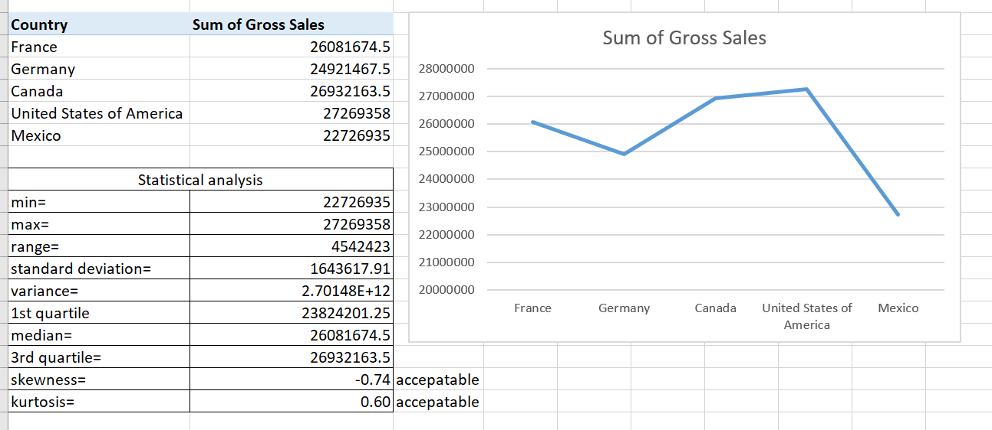
Continue…

Slide 6
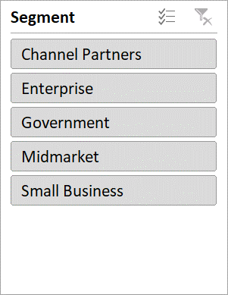
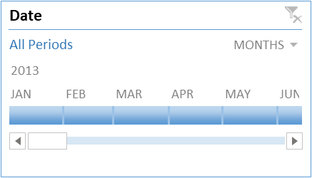
Graphical Analysis using Excel
Using Pivot tables we can derived various insights and make various relevant charts for the given data which is as follow:-
Country | Sum of Manufacturing Price
United States of America | 14246
Mexico | 13394
France | 13374
Germany | 13370
Canada | 13150
Grand Total | 67534
Product | Sum of Manufacturing Price
VTT | 27250
Amarilla | 24440
Velo | 13080
Paseo | 2020
Montana | 465
Carretera | 279
Grand Total | 67534
Notes:
In above slide, we can understand one thing that manufacturing price of similar items can vary with different countries and different market segments.
If we can apply filters on market segment and looking for particular item or segment then whole data of country & product get change accordingly.

Slide 7
Continue…
Country | Sum of Gross Sales | Sum of Profit
France | 26081674.5 | 3781020.78
Germany | 24921467.5 | 3680388.82
Canada | 26932163.5 | 3529228.885
United States of America | 27269358 | 2995540.665
Mexico | 22726935 | 2907523.11
Grand Total | 127931598.5 | 16893702.26
Notes:
From above slide , we can say that profit is higher in France though gross sales is higher in US but this value can be different if we change the segment of market which is mentioned in previous slide and taken as slicer tool in excel.
If we change the market segment to “small business” then we can find that US has obtained higher profit in that domain while Canada obtained higher profit in “channel partners” market segment.

Slide 8
Continue…
Country | Sum of COGS
United States of America | 21.64%
Canada | 20.97%
France | 20.20%
Germany | 19.47%
Mexico | 17.72%
Grand Total | 100.00%
Country | Sum of Discounts | Sum of Profit
France | 18.77% | 22.38%
Germany | 15.38% | 21.79%
Canada | 22.21% | 20.89%
United States of America | 24.33% | 17.73%
Mexico | 19.31% | 17.21%
Grand Total | 100.00% | 100.00%

Slide 9
Insert the given data into the SQL server
Open sql workbench
Open sql query tab
Create database and use it
Import csv format excel data into sql server
Start analyzing data as per requirement
To import excel data into sql server we have to do the following tasks which is as follow:-

Slide 10
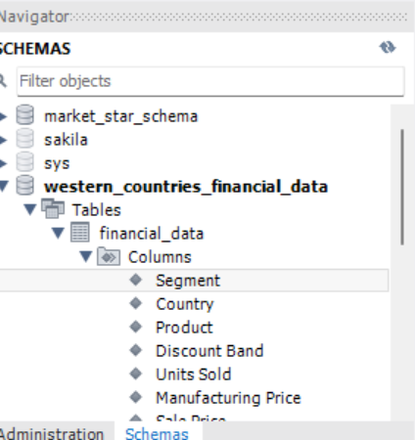
Continue…..
We have created a database named as “western_countries_financial_data”
Then we right click on table and import csv format file into sql with table name as financial_data
And then we have run some queries to check if our data is imported correctly or not.
(This is a dummy “about us” section)

Slide 11
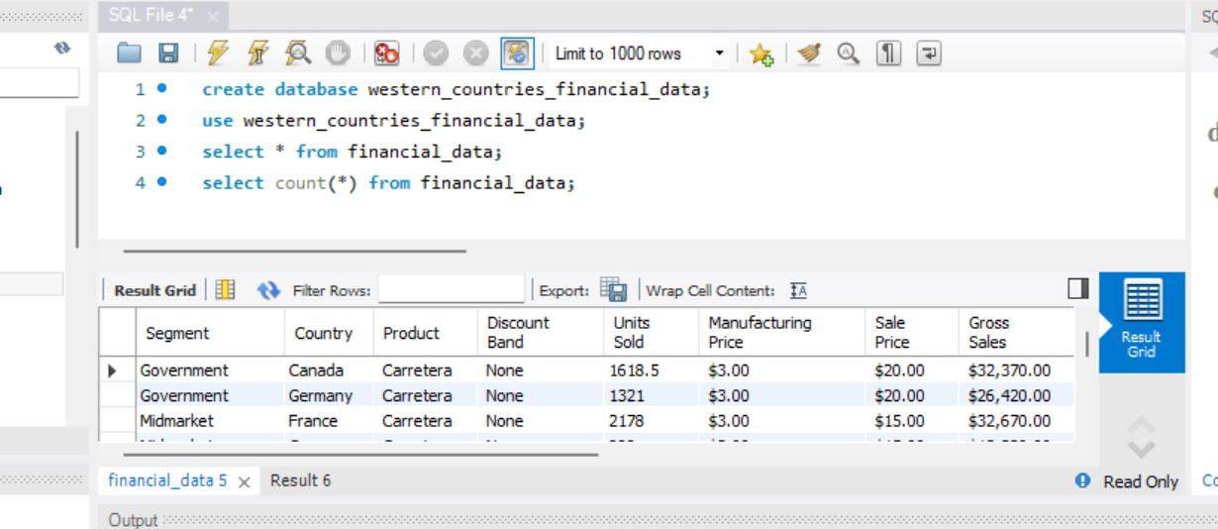
Continue….

Slide 12
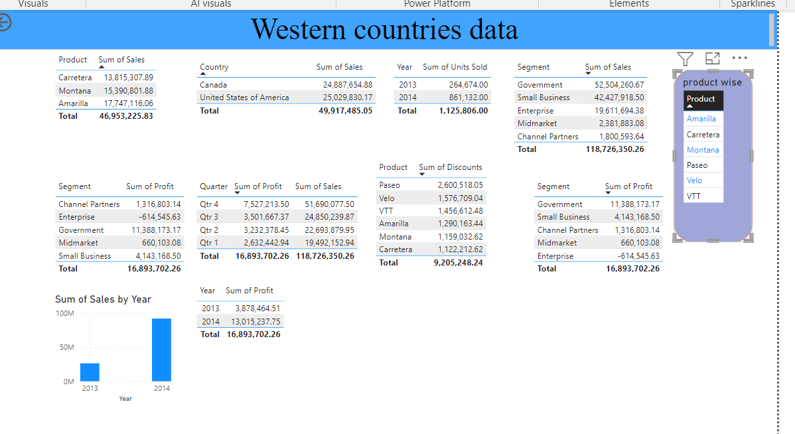
Interactive Dashboard by using visualization tools
(This is a dummy “about us” section)

Slide 13
Conclusion and Inferences
From data analysis using pivot tables in excel file & power BI, we can conclude the following things:-
Country wise manufacturing price, cogs, sales, profit , discount vary with variation in market segments and different conditions suit to different people across different regions.
Sum of manufacturing price is higher in US while lowest in Canada across different market segments, in terms of product it is highest in VTT product.
Sum of gross sales is highest in US overall while France generates highest profit across market segment including 2013, 2014, 2015 year.
In case of channel partner & government segment US making highest profit that means government provide better & competitive rates in market as compared to other segment while Canada getting more with channel partners so people are more influenced towards channel business and making more money through co-branding of products.

